Slide 1
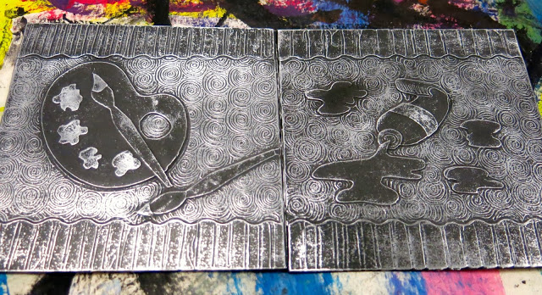
Foil Reliefs

Slide 2
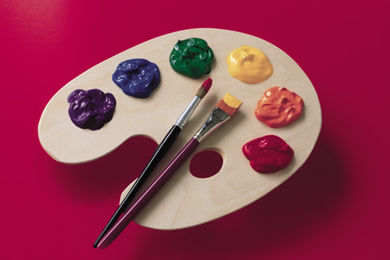
Rough Draft Drawings

Slide 3
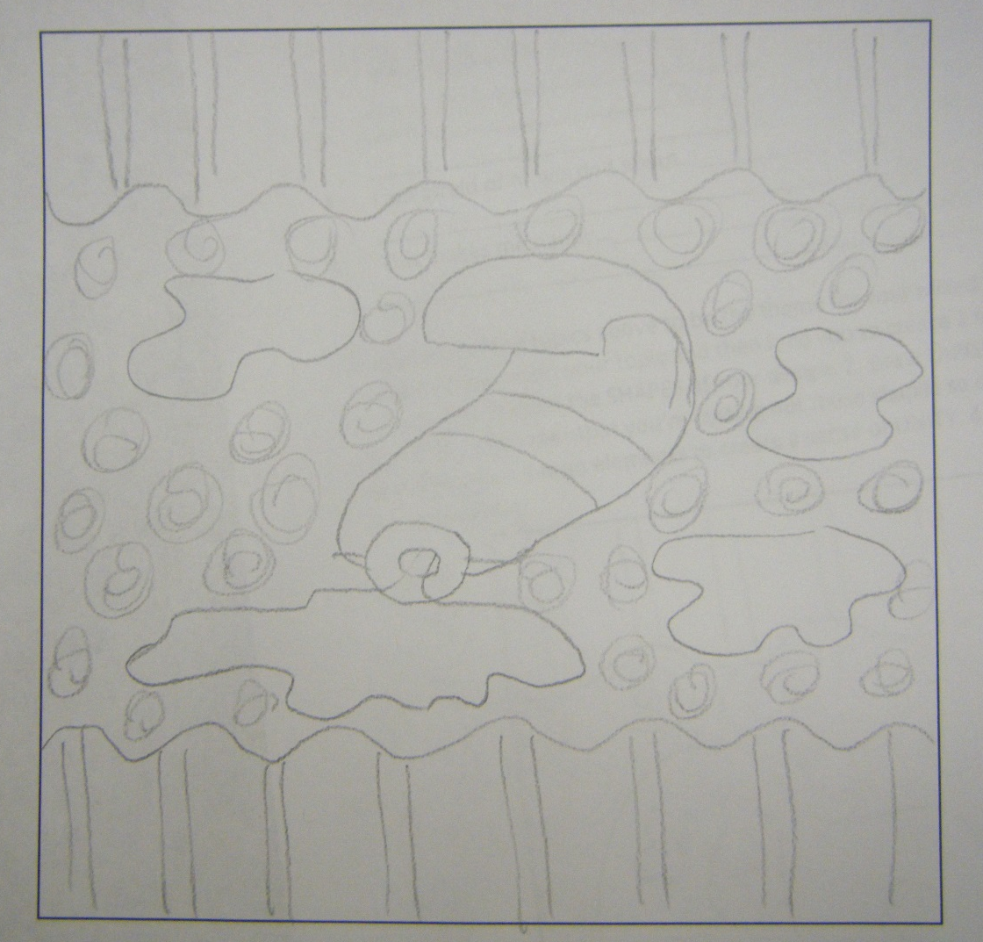
Rough Draft Drawings

Slide 4
Rough Draft Drawings

Slide 5
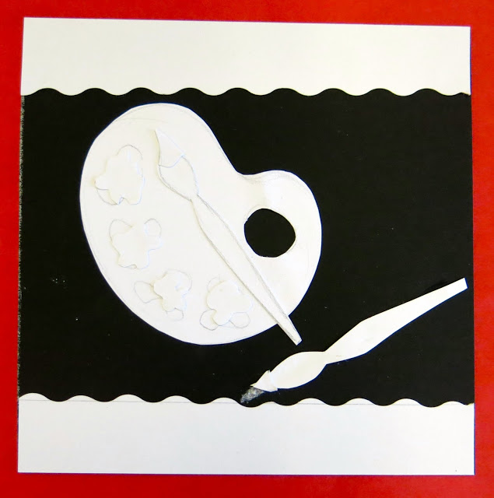
Collage the Relief
Draw your design on the rough draft square.
Plan ahead which pieces are going to be raised off the surface to create the relief.
Add a variety of levels of reliefs to show interest.
Carefully cut out and glue down the relief pieces onto your background squares.

Slide 6
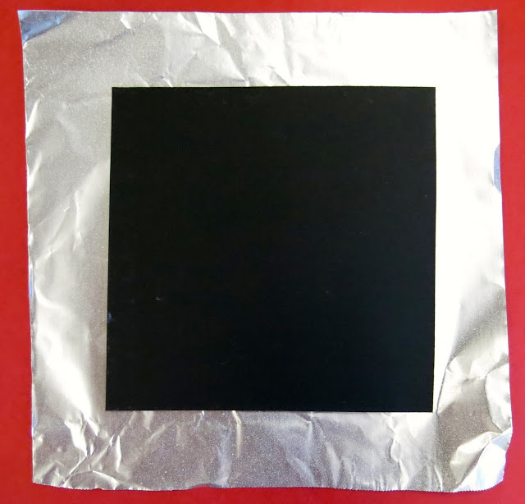
Attach Tin Foil
Lay the tin foil dull side facing up.
Spray a light coat of spray adhesive onto the foil.
Turn your dried relief face down and press onto the sticky sheet of tin foil.
Fold the edge of the tin foil down onto the back of the relief.

Slide 7
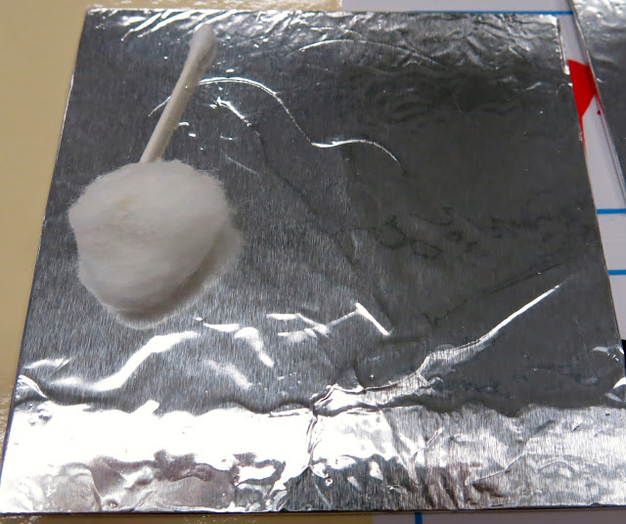
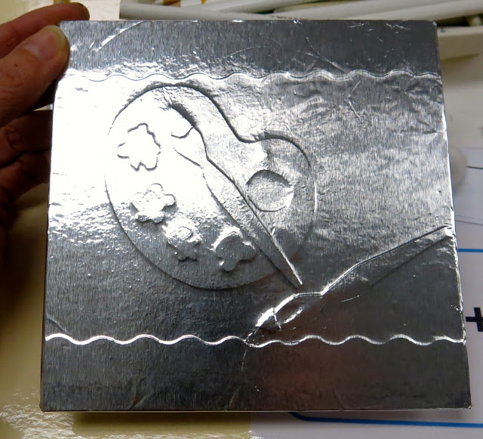
Press the Foil
Use a cotton ball or a q-tip to gently rub the surface of the tin foil to bring out the relief design.

Slide 8
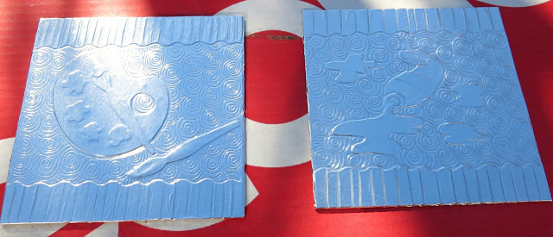
Draw Details
Use a dull pencil to draw detail impressions into the background spaces.
Only press hard enough to make an imprint and not tear the tin foil.

Slide 9
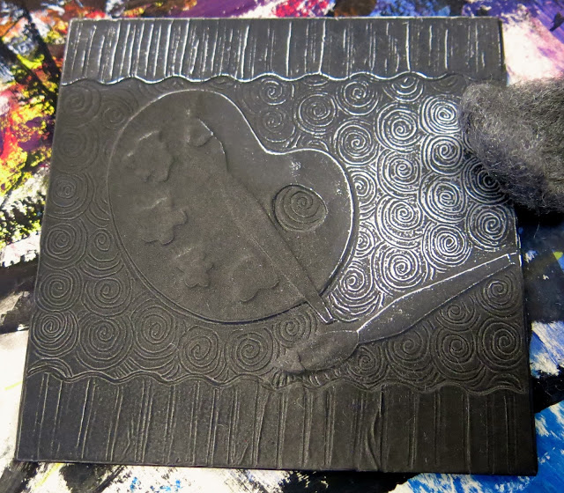
Spray with Spray Paint
Carefully spray in the hooded vent and only on your project.
Use the steel wool to gently brush off the surface spray paint to reveal the silver tin foil.
**Note only the highest points of the relief will brush off.

Slide 11
Fill in the blank for each topic with school appropriate answers. CIRCLE the theme you are choosing for your art project.
1. I dream about…____________________________________________________________________
_________________________________________________________________________________
2. I want to become…_________________________________________________________________
_________________________________________________________________________________
3. I love…___________________________________________________________________________
_________________________________________________________________________________
4. I am afraid of or worried about…______________________________________________________
_________________________________________________________________________________
5. This makes me happy…______________________________________________________________
_________________________________________________________________________________
**You can not use copyrighted logos and no words. Choose visual symbols

Slide 12
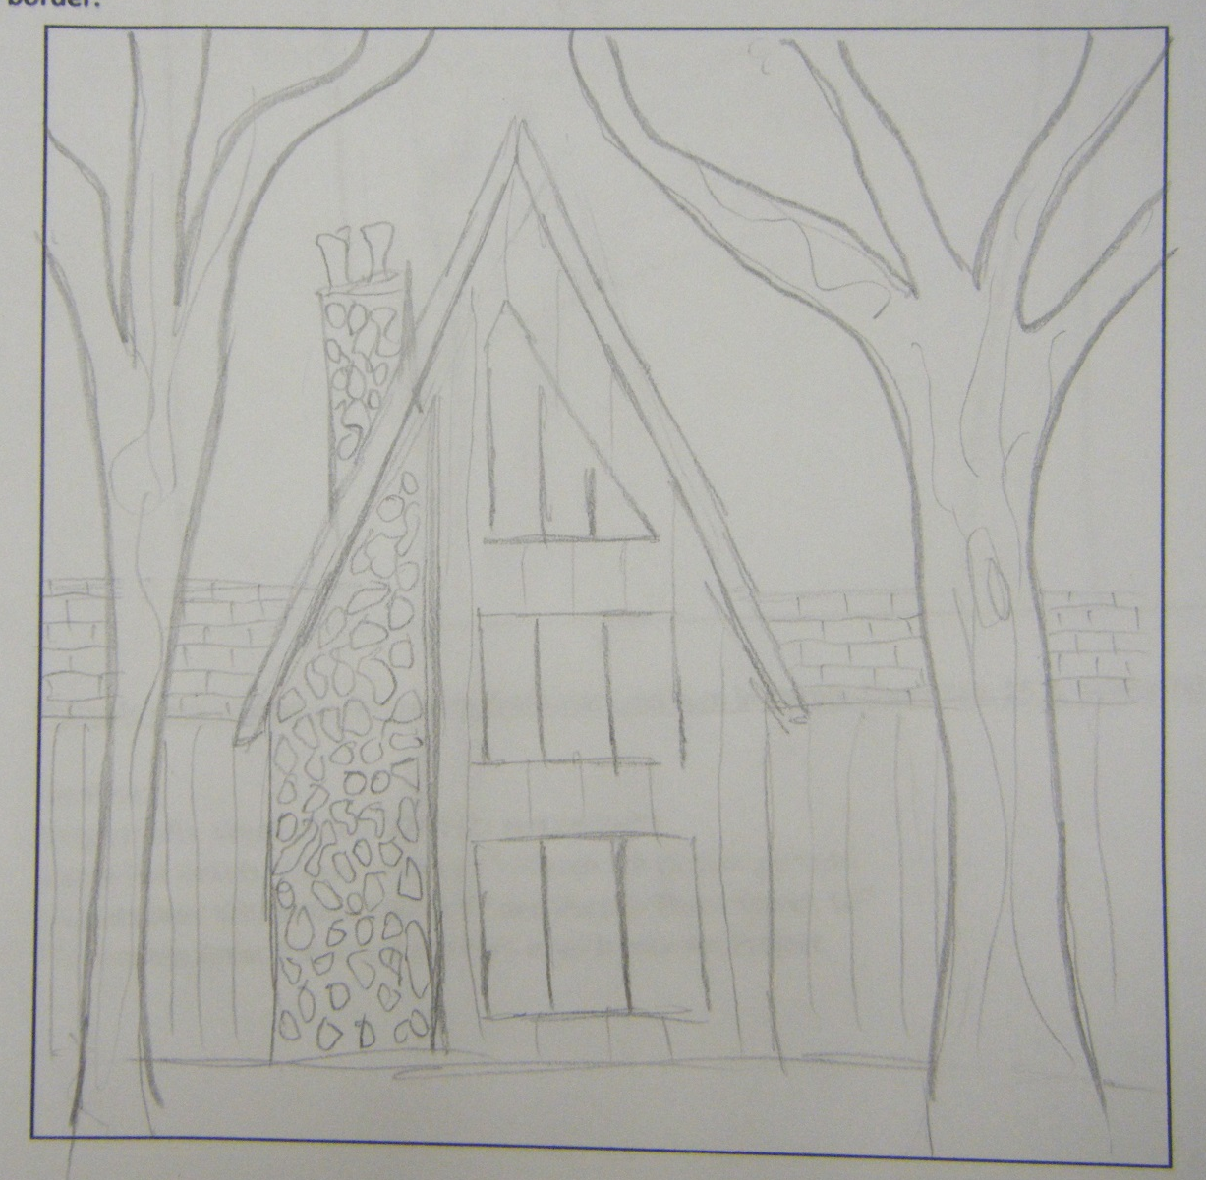
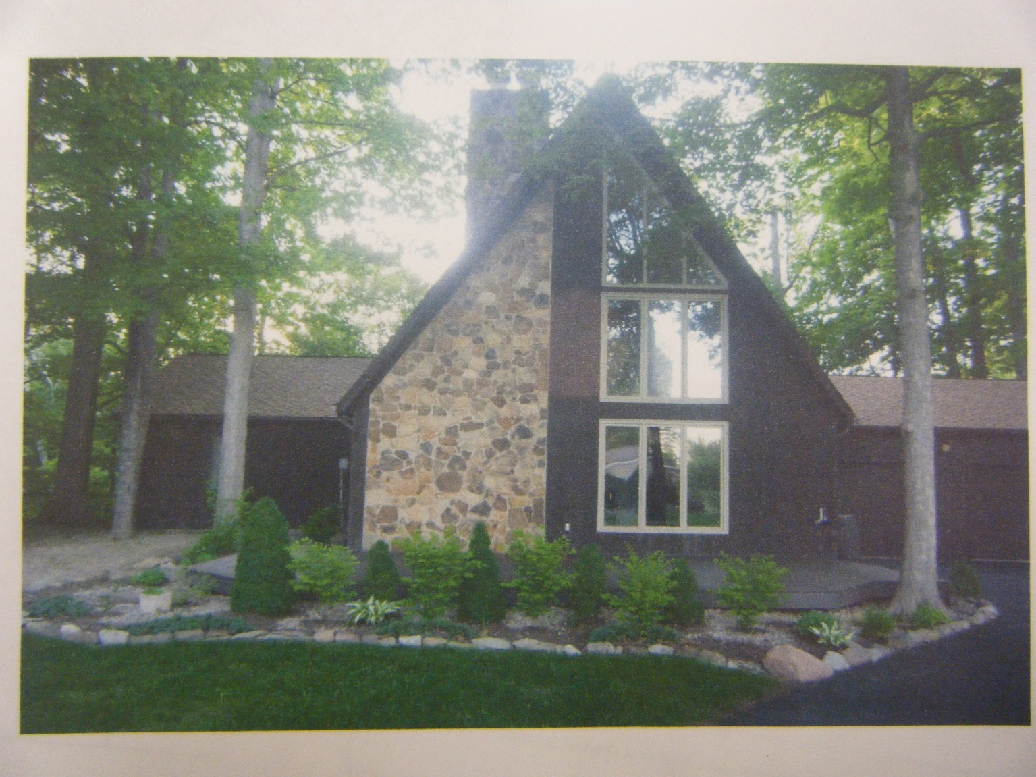
Rough Draft Drawings

Slide 13
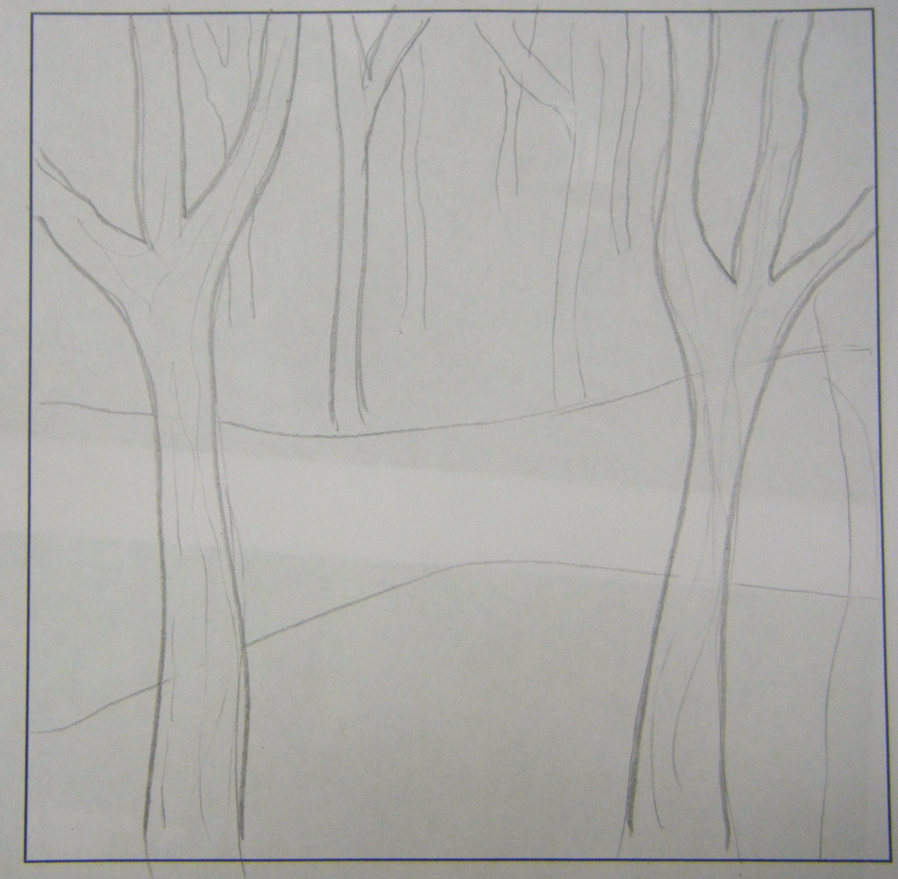
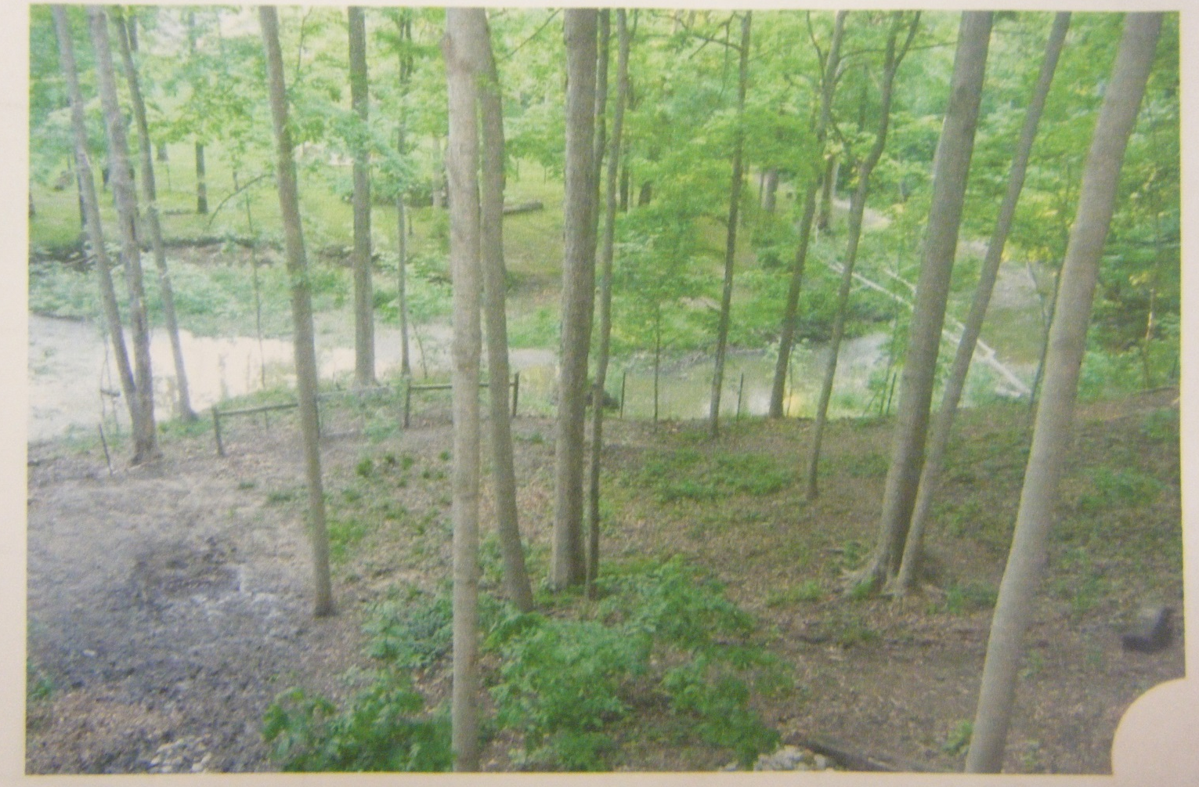
Rough Draft Drawings

Slide 14
Find 2 images that represent your theme. One image will be used for each drawing for a total of 2 drawings.
Open a Word Document.
Copy and paste the image from the website (not the thumbnail). Click on the picture>Picture Tools>Wrap Text>Through. This will allow you to resize the picture and move it around the page. You can crop the image to remove parts of the picture you will not use.
Repeat for your 2nd image and make all the images fit on ONE page.
Print ONE PAGE to EMF_216aD5100.
Pick up your print out and begin drawing your rough draft designs.
You must be printed by the end of next class!
No copyright logos and no words. For example: Nike, Ford, NBA, Sports Teams, names of people. People and animal faces will be difficult.

