Slide 1
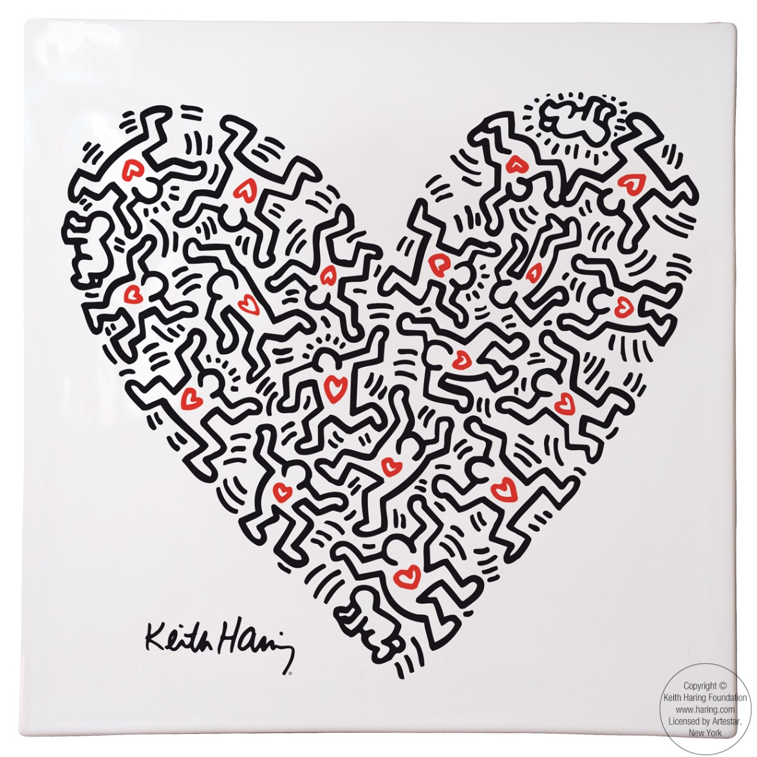
Bell Ringer:
#1 Which ELEMENT is “a continuous mark made by a moving point”?
Line
Which PRINCIPLE is “ a sense of stability in the body of work…or filling the space equally”?
Balance

Slide 2
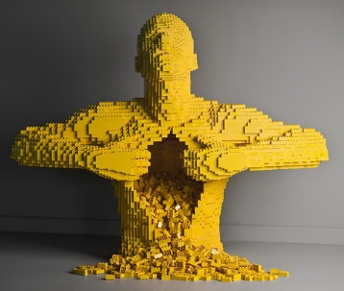
Bell Ringer:
#2 Which ELEMENT means “3D artwork like a sculpture”?
FORM
Which PRINCIPLE means “a focal point that stands out.”
EMPHASIS
https://www.youtube.com/watch?v=aiZhvHk-8PQ
Nathan Sawaya, Yellow. 2007. Lego Sculpture

Slide 3
Bell Ringer:
#3 Which ELEMENT “ shows the lightness or darkness of a color”?
Value
Which PRINCIPLE is “the visual beat” of the artwork?
Rhythm

Slide 4
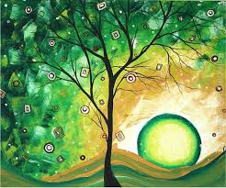
Bell Ringer:
#4 Which ELEMENT is area the around or between objects “that represents depth by showing objects far away fro you and close up to you”.
Space
Which PRINCIPLE “is repeating similar elements to show a thought out plan. It keeps the artwork simple.”
Unity

Slide 5
Bell Ringer:
#5 What ELEMENT is an enclosed area made by connecting the end of lines together or filling with blocks of color.
Shape
What PRINCIPLE “decorates the surface with planned repeated units of design.”
Pattern

Slide 6
Bell Ringer:
#6What ELEMENT represents the way a surface feels?
Texture
What PRINCIPLE is seen when your eye follows the lines and edges throughout the artwork.
Movement

Slide 7
Bell ringer:
#7 What elements represents the 12 hues on the color wheel?
Color
What principle represents using opposite together?
Contrast

