Slide 1
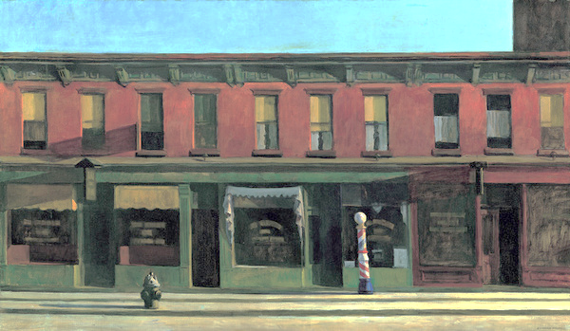
Bell Ringer:
#1 Look at Edward Hopper’s Early Sunday Morning. How do you see the principle of MOVEMENT within the image? Where does your eye travel?
For example: I see the principle of movement because…
Edward Hopper, Early Sunday Morning. 1930. Oil on Canvas

Slide 2
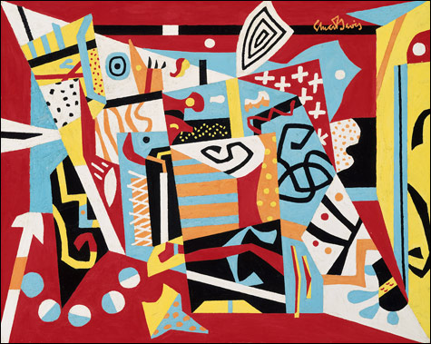
Bell Ringer:
#2 Look at the Stuart Davis painting. What 2 different elements has he repeated to show a sense of UNITY in the design?
Stuart Davis repeated_______________________________________________ to create unity in the design.
Stuart Davis, Hot Still Scape for Six Colros-7th Avenue Style. 1940. Oil on Canvas

Slide 3
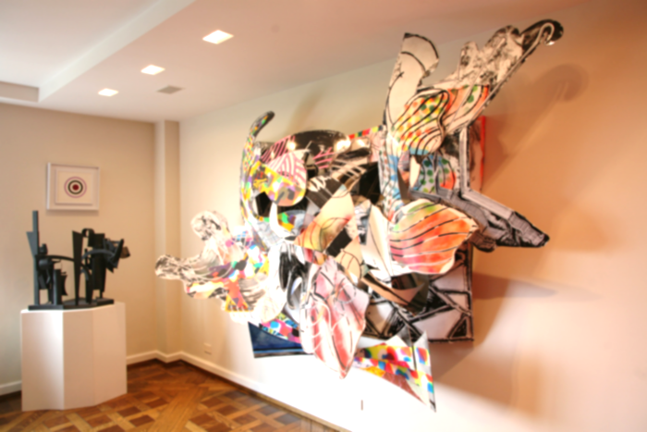
Bell Ringer:
#3 Look at the sculpture by Frank Stella. What element of art was used to make this a sculpture because we see 3-dimensions?
For Example: Frank Stella used the element of ____________ to make the sculpture 3-dimensional
Frank Stella, Forecastel Midnight. 1990 Mixed Media

Slide 4
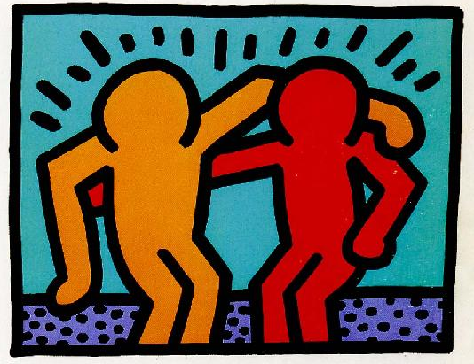
Bell Ringer:
#4 Look at Keith Haring, Best Buddies. What element does he use to define the edges of the people and to show energy?
For example: Keith Haring used the element of __________ to define the edges of the people.
Keith Haring, Best Buddies. 1990. Silkscreen

Slide 5
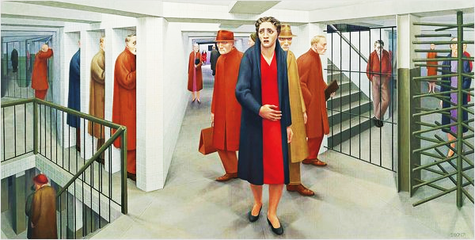
Bell Ringer:
#5 Look at George Tooker’s, The Subway. Your attention is drawn to the people because their clothes are primary colors and stand out. What principles does this represent if there’s a focal point?
George Tooker showed the principle of ___________ by making the people wear primary colors to stand out.
George Tooker, The Subway. 1950. Oil on Canvas
Credit Line

Slide 6
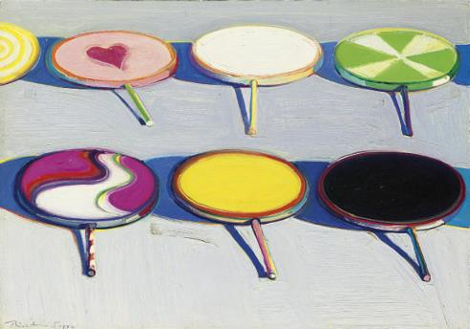
Bell Ringer:
#6 Look at Wayne Thiebaud’s Seven Suckers. The suckers show a variety of hues like yellow, green, pink, and red. What element represents the 12 hues on the color wheel?
For Example: Wayne Thiebaud uses the element of__________ to show the hues on the surface of the suckers.
Wayne Thiebaud. Seven Suckers. 1970. Oil on Canvas

Slide 7
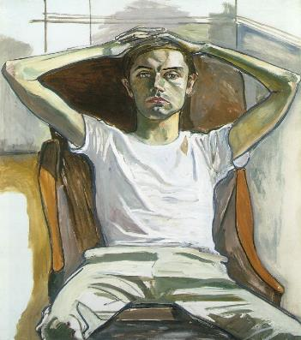
Bell Ringer:
#7 Look at the painting by Alice Neel. We see shadows in the clothes and on the skin. We also see the dark brown chair and the light colored clothes. What principle refers to using opposites like light and dark?
Alice Neel uses the principle of_________ in the light and dark shadows.
Alice Neel, Hartley. 1965. Oil on Canvas

Slide 8
Bell Ringer:
#8 Look at the painting by Kehinde Wiley. ANALYZE the artwork by identifying one element and one principle and provide specific examples of how the element and principle were used.
**You may use your notes**
For example: Kehinde Wiley used the element of ________________ because I see_________________.
He also used the principle of __________ because____________________.
Kehinde Wiley, Samuel Johnson. 2009. Oil on Paper

